Slide 1
UTI
Unisys Threat Intelligence

Slide 2
PROBLEM STATEMENT
Develop a Threat Intelligence application and its Dashboard
Organization X is wary of open-source code and wants to keep a tab of all the possible vulnerabilities and threats in their products.
Create a threat intelligence application for organization X that extracts and collates information from various vulnerability databases such as NVD, WhiteSource, etc., and presents the information in a data visualization dashboard.

Slide 3
SOLUTION
Security vulnerabilities are disclosed publicly, they are prime targets for hackers. If you’re not regularly managing your open source components and all their dependencies, your organization is at risk.
This Application is used to prepare, prevent, and identify Cyber Threats looking to take advantage of valuable resources.

Slide 4



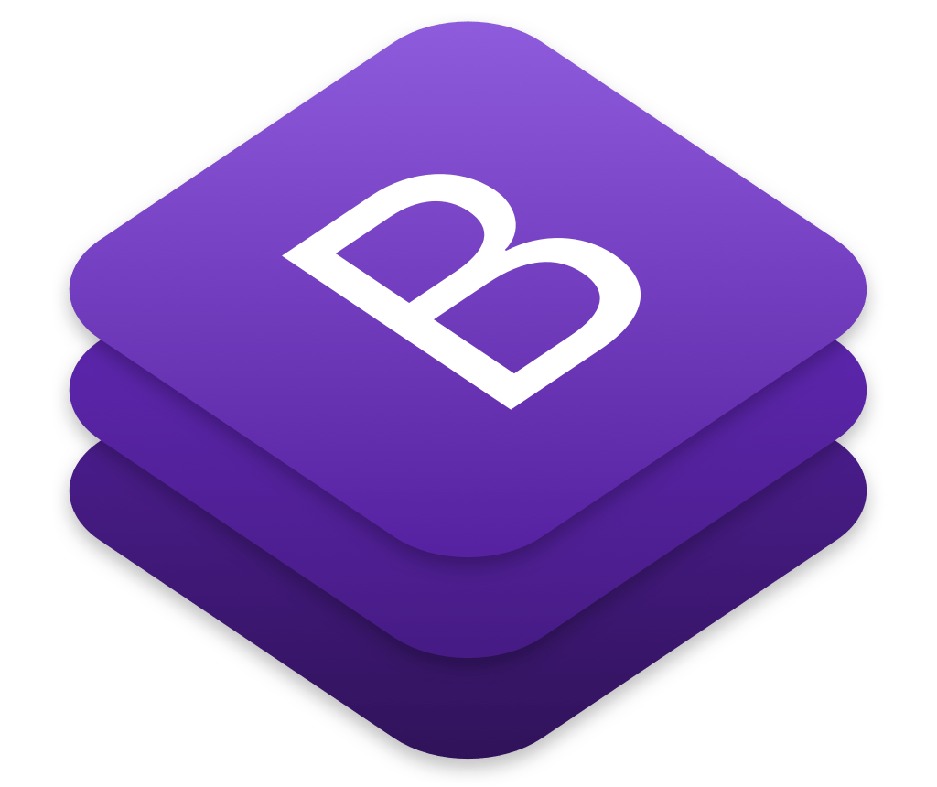
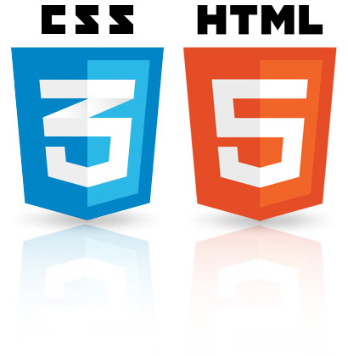
TOOL STACK

Slide 5
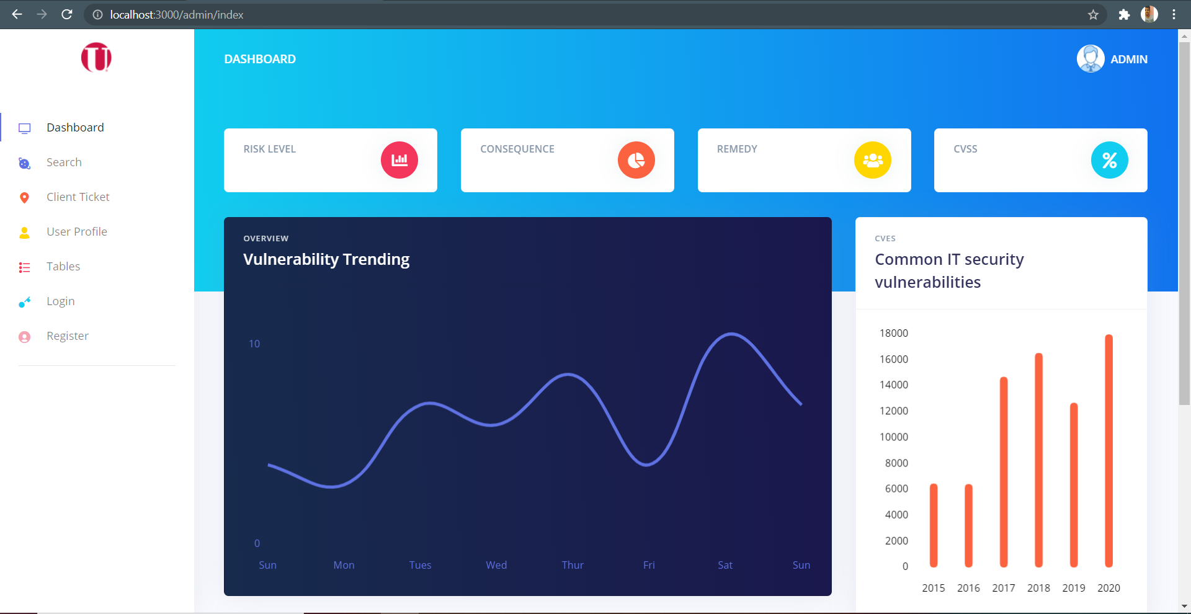
DASHBOARD

Slide 6
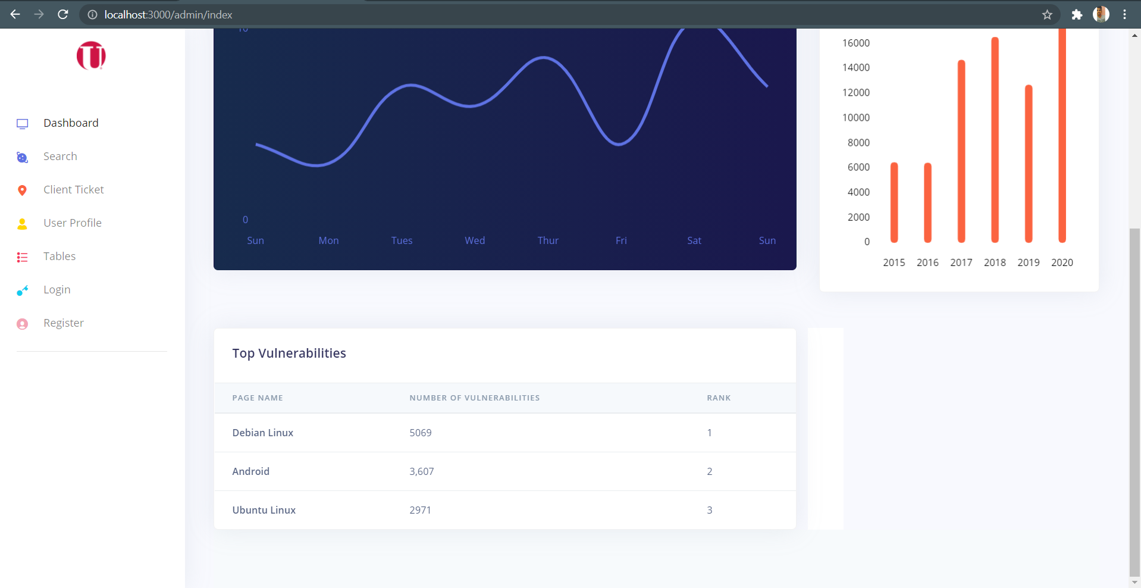
DASHBOARD

Slide 7
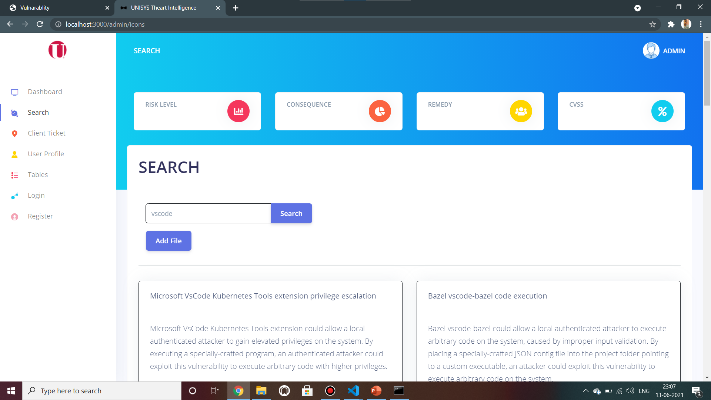
SEARCH-VULNERABILITY

Slide 8
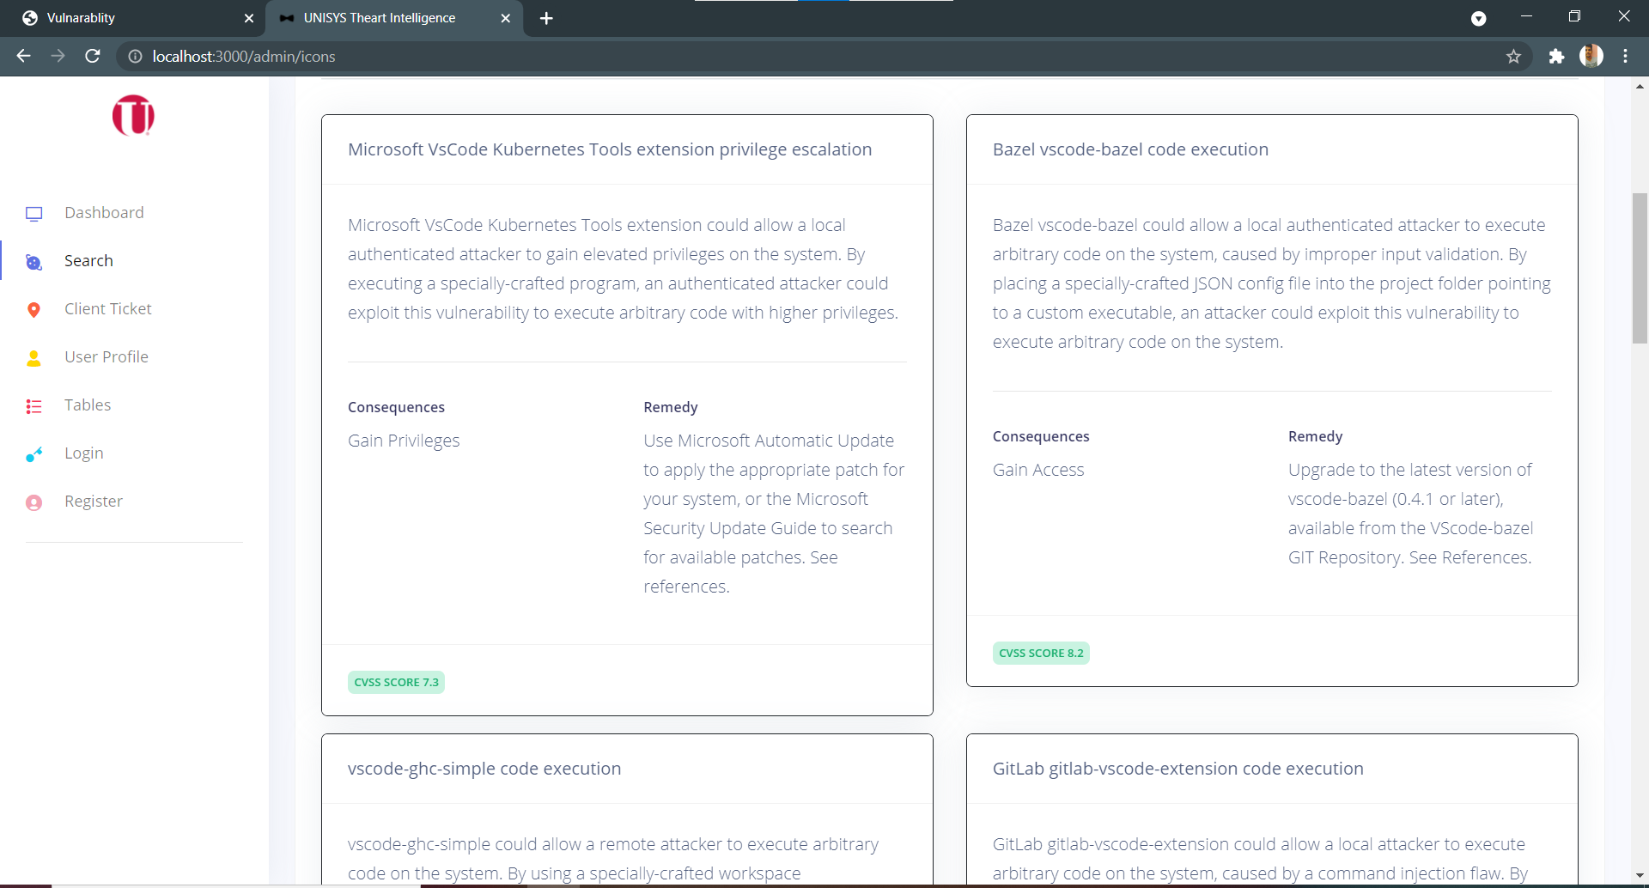
SEARCH-VULNERABILITY

Slide 9

SEARCH-VULNERABILITY

Slide 10
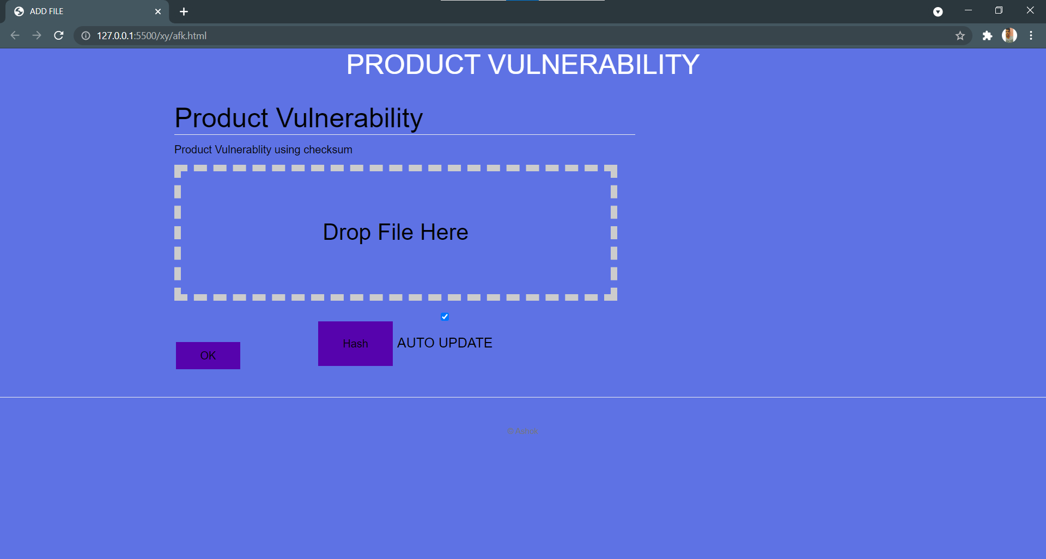
SEARCH-VULNERABILITY

Slide 11
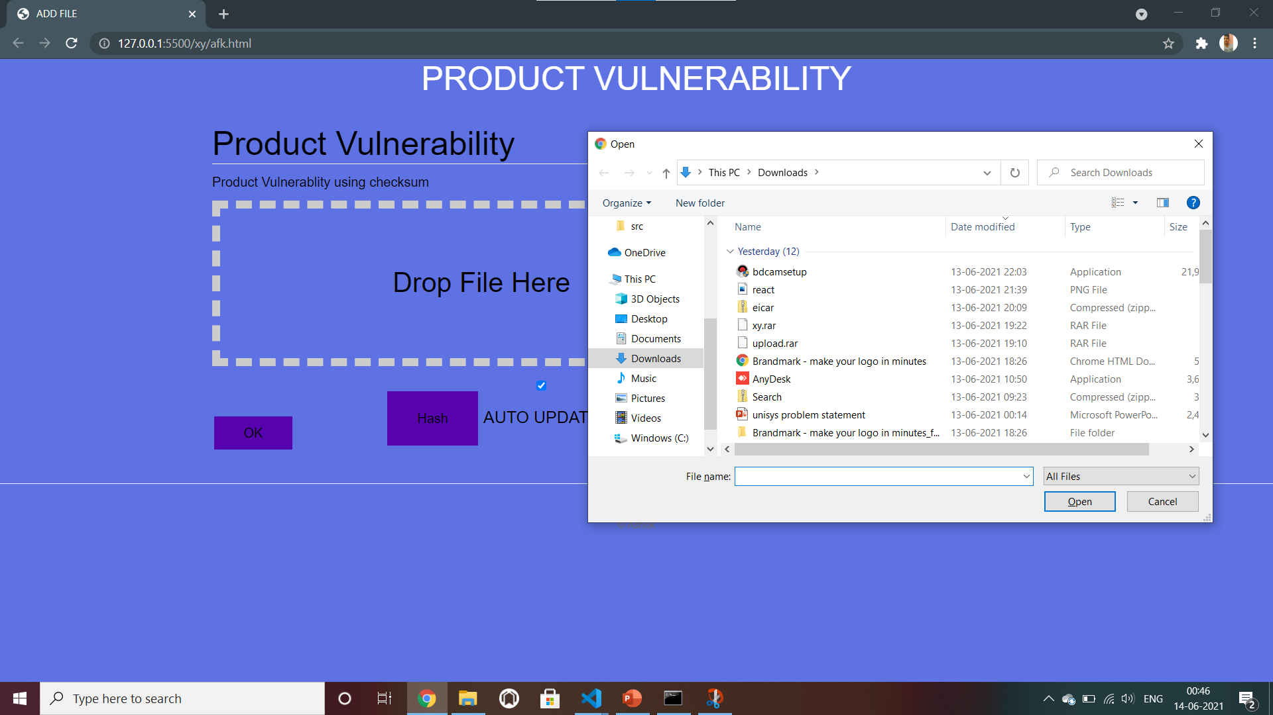
SEARCH-VULNERABILITY
Virus File

Slide 12
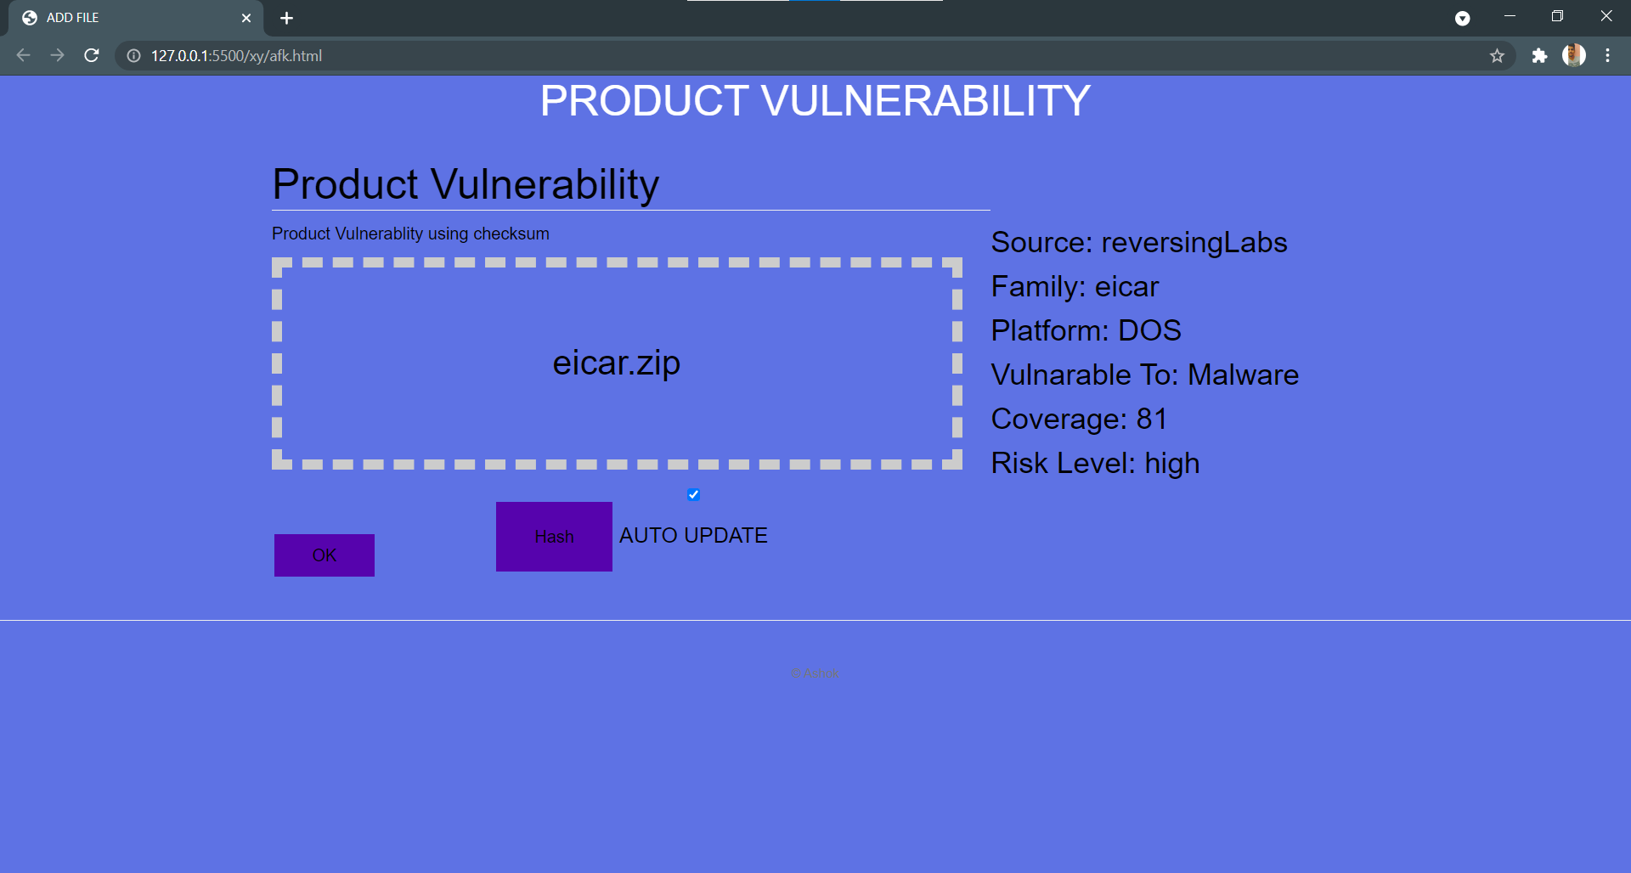
SEARCH-VULNERABILITY

Slide 13
FUTURE IDEAS
LOGIN
TABLES
CLIENT
USER PROFILE

Slide 14
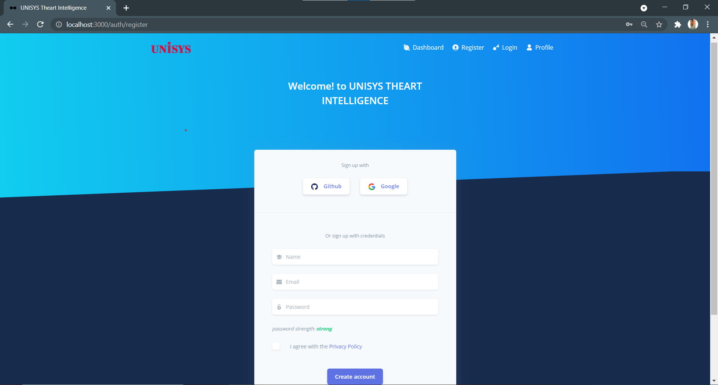
LOGIN

Slide 15
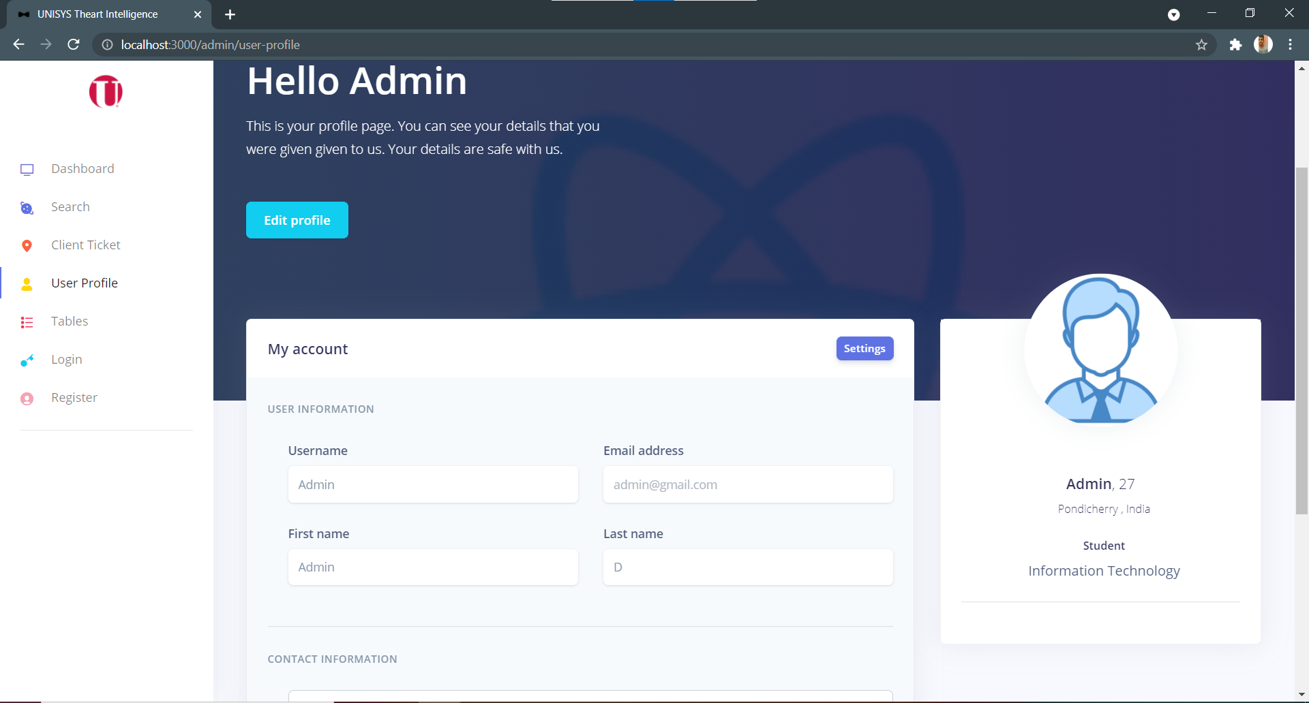
USER PROFILE

Slide 16
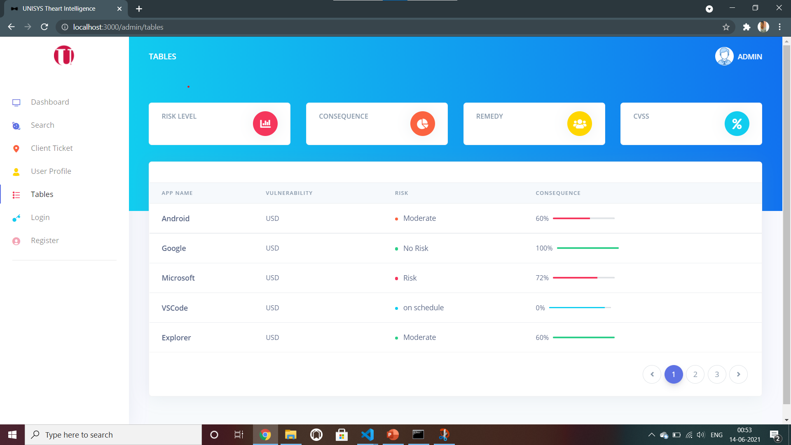
TABLES

Slide 17
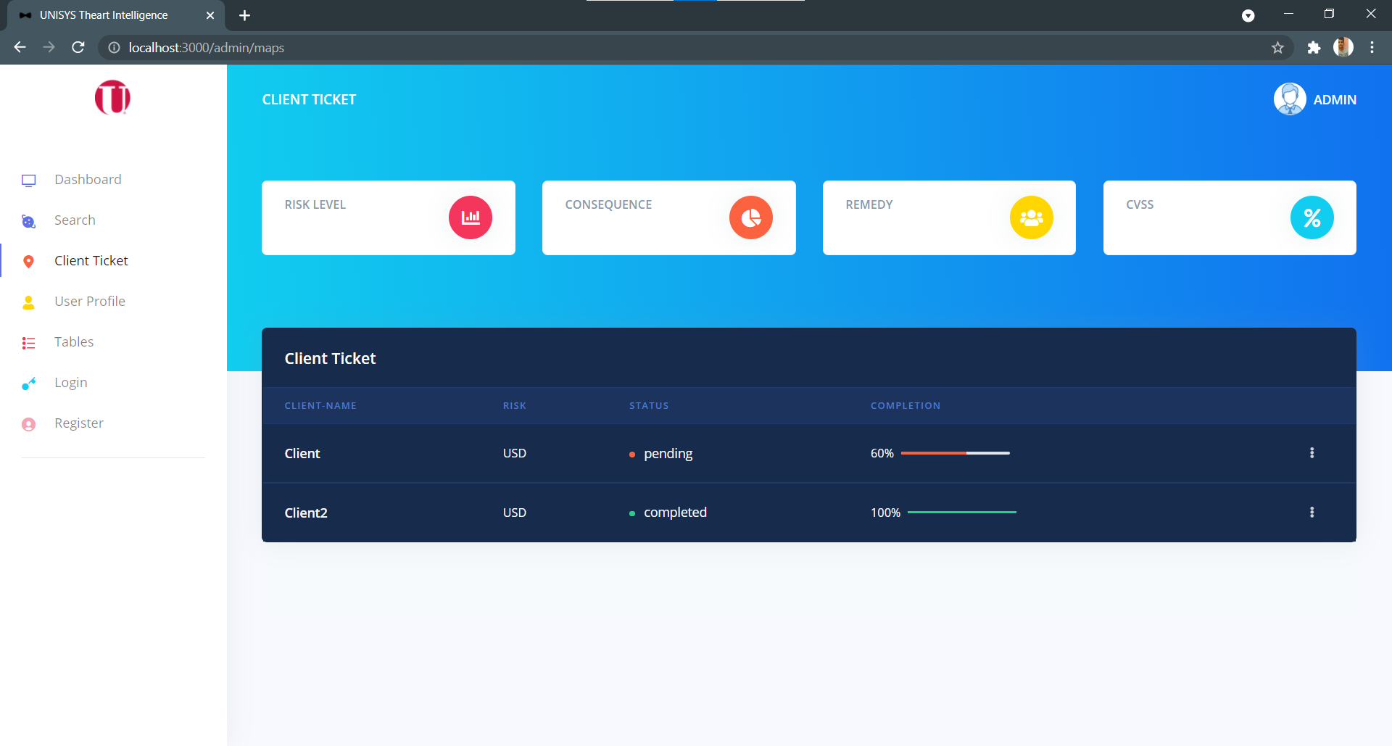
CLIENT PROFILE

Slide 18
OVER COMING THE PROBLEMS FACED DURING THE IMPLEMENTATION

Slide 19
LIVE DEMO

Slide 20
PROJECTS I HAVE WORKED ON
MED-AMI WATCH BOT
VIRTUAL REALITY ENFORCING ORGANIZATIONAL SAFETY
AND TRAINING
EMAIL : ashokkumaravel02@gmail.com
GITHUB: https://github.com/Ashok17kumaravel/THREAT-INTELLIGENCE

Slide 21
THANK YOU!!

